Slide 1


International Christian Accreditation Association
ICAA Accreditation and Reaccreditation—It’s All about the Evidence
Dr. Gwetheldene Holzmann and Dr. Mary Lou Miller
Graduate School of Education
Oral Roberts University

Slide 2
Assessment Cycle
The Assessment Cycle
What should students learn?
What difference did it make?
When do students learn the outcomes?
How can we improve student learning?
What are they actually learning?
Are students meeting the learning outcomes?
What evidence shows students are learning?

Slide 3
Why is Scope and Sequence important?
Provides a roadmap for new teachers
Helps teachers and parents of new students understand what skill sets students may have or need
Keeps faculty and administration on the same page regarding student progress
Tracks growth academically AND spiritually

Slide 4
Critical Evidence
Assurances
Cultural Context Domain
Leadership Capacity Domain
Learning Capacity Domain
Resource Capacity Domain

Slide 5
Assurances
  Establishing who you are and how you operate
    Statement of Faith
    Vision/Mission
    Christian philosophy of education
    Commitment for spiritual growth and Biblical instruction
    Legal and fiscal operations
    Policies and procedures are established
      Discontinuance
      Security/Safety
      Continuous improvement
      Substantive Change

Slide 6
Assurances
  Be sure the Reviewer can locate all the information related to this Domain.
    Have folders for each Assurance with examples of evidence.
    Can provide links to examples in Comment boxes

Slide 7
Cultural Context
  Mission/Vision/Purpose statements form the foundation for identity, culture, and student success including spiritual growth
    Processes and procedures
    Spiritual formation goals
    Curriculum
      Biblical integration
      Biblical worldview
    Personnel performance and professional development
  Documented in writing
  Living curriculum

Slide 8
Leadership
  Essential Element of Institutional Effectiveness
    Fidelity to purpose and direction
    Well documented
    Involves all stakeholders
    Continuous improvement
    Measurable results
    Student learning
    Practice

Slide 9
Leadership
    Institutional effectiveness
      Ethics
      Evaluation processes
      Support of teaching and learning
    Opportunities for leadership development
    Mentoring
    Team building

Slide 10
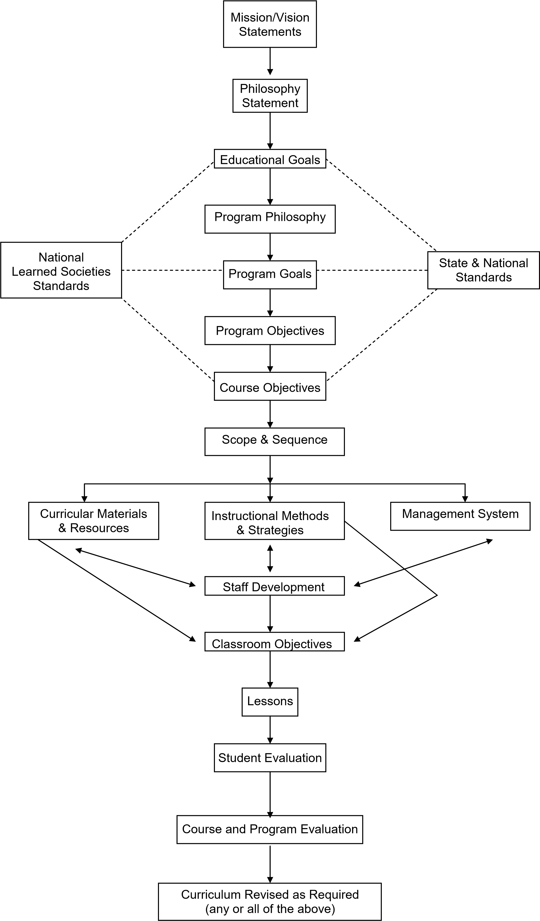
Learning Capacity 1-6

Slide 11
Learning Capacity 1-6
  Learning standards incorporate high expectations and differentiated instruction
    Content
      Biblical integration and Biblical worldview
    Attitudes
      Student engagement
    Beliefs
      Spiritual formation goals
    Skills
      Collaborative problem solving
      Creativity
      Innovation

Slide 12
Learning Capacity 1-6
  Scope and sequence
  Curriculum guides
  Examples
    Curricular alignment
      Horizontally
      Vertically
    Documented process of curricular review
    Data
    Documentation of data analysis that informs decision-making process

Slide 13
Learning Capacity 7-12
  Instruction monitored and adjusted to meet learner’s needs
  Spiritual
  Social
  Emotional
  Developmental
  Academic
    Continuous assessment and evaluation
    Formative
    Summative
    Documentation of data analysis that informs decision-making process

Slide 14
Resource Capacity 1-4
    Documented process for planning and delivering professional development for all staff
      Aligns with learner environment and performance
      Aligns with organizational effectiveness
    Induction, mentoring, and coaching programs
      Specific learning objectives
      Monitored
      Evaluated
      Modified
    Promotes collaboration and collegiality
      Collect data
      Analyze data
      Discuss impact of results on performance

Slide 15
Resource Capacity 1-4
    Personnel are attracted and retained that support the purpose and direction of the school
      Documented process
      Evaluation
      Meet needs
      System of support
      Promotes growth and opportunities
    Examples
      Crosswalk showing how professional learning relates to school purpose/mission, student needs, and teacher/staff evaluations
      Individual professional development plans
      Budget lines, calendar, schedules, agendas, minutes
      Handbooks, job descriptions, salary schedules, Board minutes
      Needs assessments for personnel

Slide 16
Resource Capacity 5-8
    Documented process for identifying, acquisition, use, and review of digital and information resources
      Aligns with curriculum and organizational needs
      Align with mission/purpose, Christian philosophy and Biblical principles
      Demonstrate how the process is used
        Data
        Types of resources used
    Documented process for resource management
      Long-range planning aligned with needs
        Fiscal, material, and human
    Examples
      Technology needs assessments and improvement plans
      Examples of teacher use in classroom and as learning tool

Slide 17
Input versus Output
  Capture it!
Examples
  Submit evidence that is required but also evidence that shows your uniqueness
  Build evidence over time in designated repository
    Exemplary in that it moves student to next level
    From all levels-elementary, middle, and high school
  Have a narrative page that indicates what evidence you are submitting for each standard and why it is included.
    Help the reviewers make sense of what you are submitting!

Slide 18
Input versus Output
Examples
  Schedule faculty meetings each semester to discuss data and solutions for continuous improvement
  Show you are reflecting on practices and student learning outcomes
  Document, document, document!

Slide 19
Organization of Evidence
Use your self-study to frame your organization
Folders, folders, folders!
Google Drive
One Drive
Dropbox
School’s Shared Drive
Document explaining connection of evidence to specific standards
To hyperlink or not to hyperlink?
Pros and Cons

Slide 20
What is Outcomes-based Evidence?
Indicates reflective practice
Demonstrates changes based on evaluation and assessment of evidence
Capture it!
Minutes, along with agendas!

Slide 21
Data Analysis
Are students meeting the learning outcomes?
Assess changes in student performance indicators
  Identify gaps between the desired and actual
Analyze the assessment results
  What’s working? What’s not?
What needs to change to increase student performance?
Document the discussions

Slide 22
Data Analysis
How can the results be used to improve learning?
Discuss regularly the insights on strengths and weaknesses
Draw conclusions
Propose solutions
Make decisions on changes needed for improvement
Document the discussions, the decisions made, and the implementation timeline and responsibilities

Slide 23
Data Analysis
What difference did the change make?
Evaluate the impact of changes implemented
  Gather evidence
  Analyze the data
  Draw conclusions
    Were results what you expected?
    If not, what needs to change?
Repeat the cycle

