Slide 1
International Christian Accreditation Association
eleot®
(Educational Learning Environment Observation Tool)
Overview

Slide 2
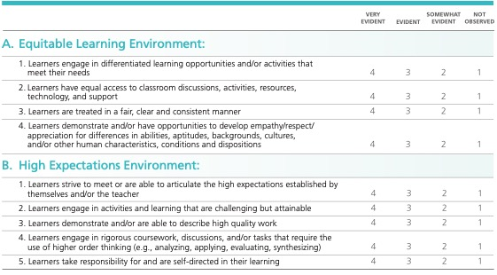

Slide 3
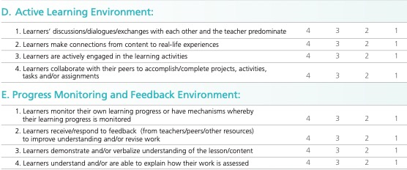

Slide 4
