Slide 1


International Christian Accreditation Association
Readiness for Accreditation
and
Internal Review

Slide 2
Accreditation Readiness Diagnostic
Completed while at Pre-Candidate status
Assesses school’s capacity for accreditation
  Initial compliance with Assurances
  Initial performance level for each indicator
  Initial analysis of strengths and weaknesses
Prepares school to begin its full Internal Review
Evidence should drive determination of performance levels, not visa-versa
Notes:
Refer to Accreditation Readiness Diagnostic document – briefly review document

Slide 3
Power and Purpose of Internal Review
Provides a framework for school dialogue and important discussion
Produces valid evidence to inform action
Positions school to strategically improve
Provides context and information to the External Review Team
Analyzes student performance
Involves stakeholders in the continuous improvement of the school
Helps ensure school remains focused on its mission
Notes:
Ask: Why is an Internal Review important to a school?
Use buzz groups of two to discuss this for 3 minutes. Share responses as time permits.

Slide 4
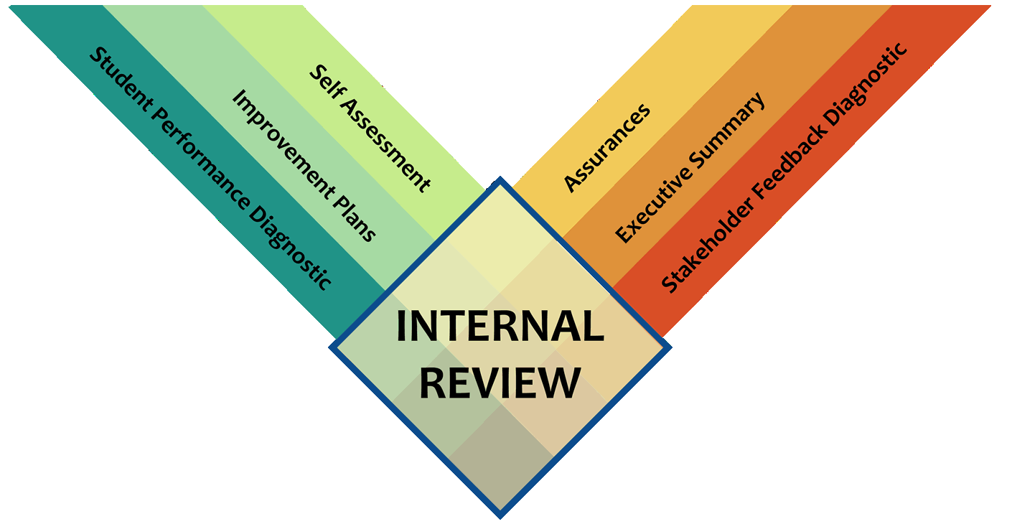
Components of Internal Review
Self-Assessment
Notes:
This slide just shows the 6 elements of the Internal Review process
Define and briefly explain the components of the Internal Review
Demographics
Institution size, type, to provide context
Executive Summary (Now called School Profile and Executive Summary)
General overview, context of institution
Self-Assessment
Thoughtful and deliberate reflection of current status
Assurances
Policy and procedure statements
Student Performance
Analysis of results over time
Reflects status and improvement
Stakeholder Performance
Analysis of feedback from stakeholders
Improvement Plan(s)
Alignment of improvement goals with diagnostic results

Slide 5
Components of Internal Review
School Profile and Executive Summary
  Demographics – size, location, enrollment, head of school,
  primary contact
  “Tells the Story”
Stakeholder Surveys – Parent, Student, Staff perceptions
Student Performance – Data informs improvements
Assurances – Collect evidence to support
Self-Assessment – Based on collected evidence
Goals/Improvement Plan -- Data-driven road map to continuous school improvement

Slide 6
External Review
2-3 Day Visit
Verification of School’s Documents/Diagnostic Data
Artifacts
Interviews
Classroom and General Observations
Exit Report
External Review Visit Accreditation Report

